Slide 1
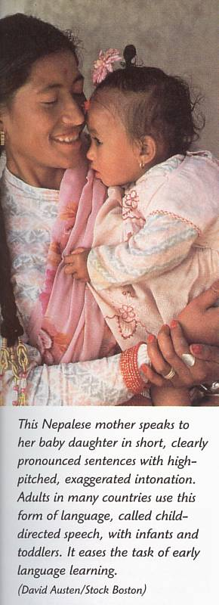
Language Development
Prelinguistic Development
Berk L 2000. Child Development 5th Ed. Boston, Allyn and Bacon, p6368.
© Nielsen, 2010

Slide 2
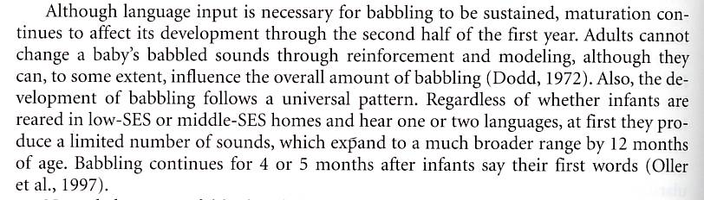
Language Development
Prelinguistic Development
Berk L 2000. Child Development 5th Ed. Boston, Allyn and Bacon, p368.
© Nielsen, 2010

Slide 3
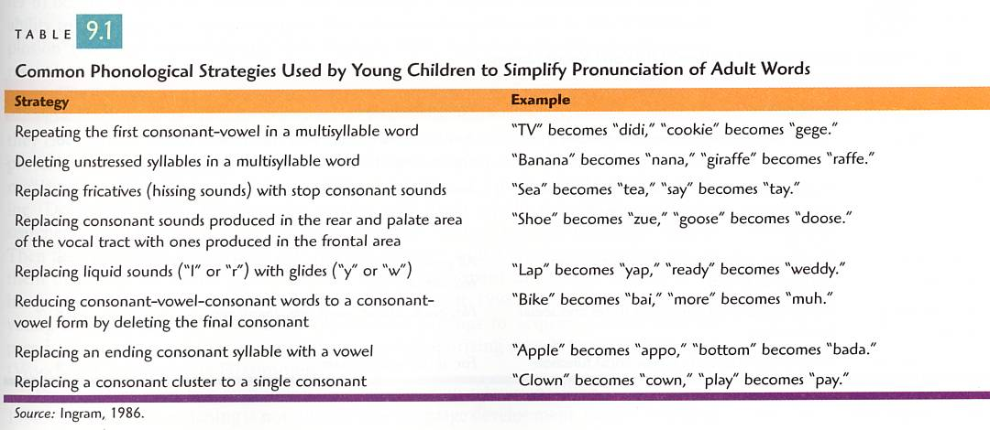
Language Development
Prelinguistic Development
Phonological development
Berk L 2000. Child Development 5th Ed. Boston, Allyn and Bacon, p371.
© Nielsen, 2010

Slide 4
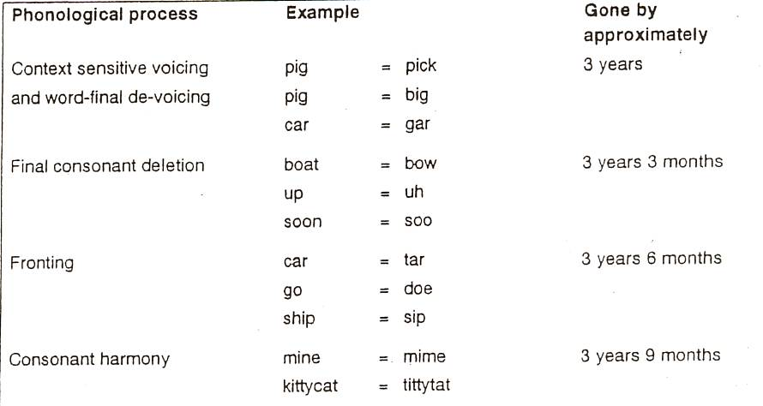
Language development - Phonology
© Nielsen, 2010

Slide 5
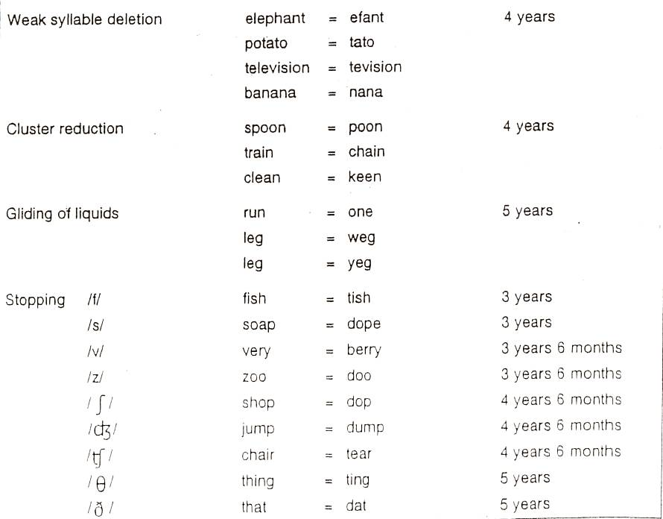
Language development - Phonology
© Nielsen, 2010

Slide 6
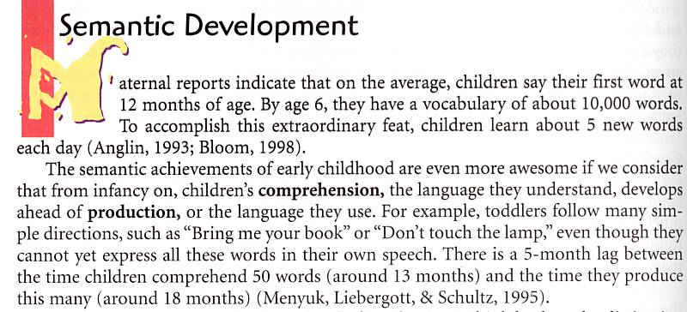
Language Development
© Nielsen, 2010
Prelinguistic Development
Phonological development
Semantic Development

Slide 7
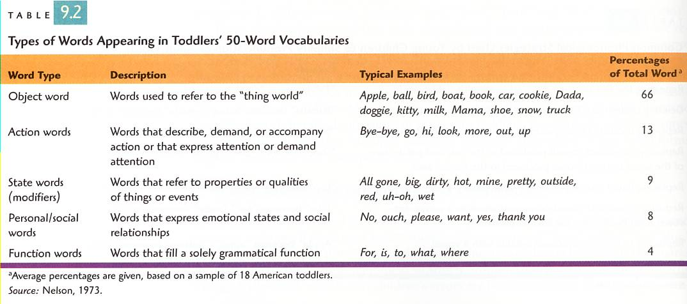
Semantic development. . . Vocabulary development?
Berk L 2000. Child Development 5th Ed. Boston, Allyn and Bacon, p372.
© Nielsen, 2010

Slide 8
Language Development - Vocabulary
© Nielsen, 2010
The critical period for the development of language is from birth to adolescence.
6 years – 10 000 words
Adolescent – 40 000 words
What role does the teacher play in this development?

Slide 9
Language development - Vocabulary
© Nielsen, 2010
Research has shown that at the age of 3 (4th Birthday)
Children with professional parents have heard approximately 43 million words
Children with working parents have heard approximately 23 million words
Children whose parents are unemployed (on welfare) have heard approximately 13 million words.

Slide 10
Language development - Vocabulary
43 million words
23 million words
13 million words
This has been called “The 30 million word gap”
Hart B and Risley T R 2003. The Early Catastrophe. The 30 Million Word Gap by Age 3. The American Educator, Spring.
© Nielsen, 2010

Slide 11
Language Development and Self-concept
Affirmations and Prohibitions:
Professional family – 560 000 more affirmations than prohibitions
Working class family – 100 000 more affirmations than prohibitions
Welfare family – 125 000 more prohibitions than affirmations
Hart B and Risley T R 2003. The Early Catastrophe. The 30 Million Word Gap by Age 3. The American Educator, Spring.
© Nielsen, 2010

Slide 12
Language development - Grammar
Children learn language by constructing their own grammars (i.e., sets of internalized rules) and they
do this by a process of analysis: constructing, testing and modifying hypotheses about the sentences they encounter. At first, these hypotheses amount to guesses about the nature of the rules that underlie
the sentences of the language. The rules are incorporated into the child’s developing grammar, which in time more and more closely approximates the grammars of the adult speech community.
Lamb P 1977. Linguistics in Proper Perspective, p14.
© Nielsen, 2010

Slide 13
Language development - Grammar
Children learn language by constructing their own grammars (i.e., sets of internalized rules) and they
do this by a process of analysis: constructing, testing and modifying hypotheses about the sentences they encounter. At first, these hypotheses amount to guesses about the nature of the rules that underlie
the sentences of the language. The rules are incorporated into the child’s developing grammar, which in time more and more closely approximates the grammars of the adult speech community.
Lamb P 1977. Linguistics in Proper Perspective, p14.
© Nielsen, 2010

Slide 14
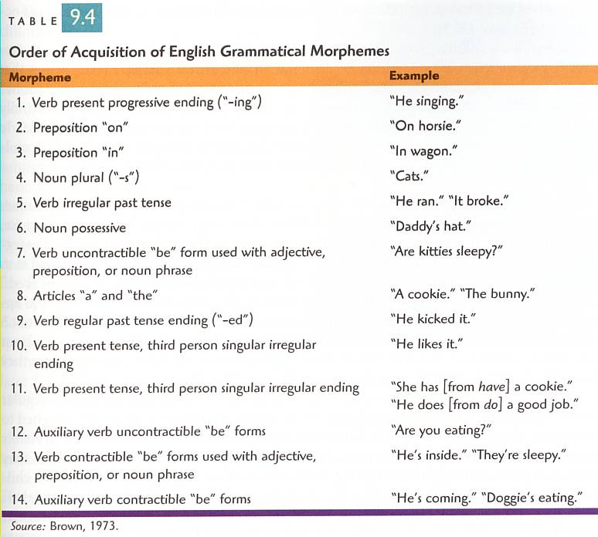
Language development - Grammar
Berk L 2000. Child Development 5th Ed. Boston, Allyn and Bacon, p381.
© Nielsen, 2010

Slide 15
Language Development
Prelinguistic Development
Phonological development
Semantic Development
Grammatical development
Pragmatic Development

Slide 16
Language development- Pragmatics
© Nielsen, 2010
As the child begins school they are learning about conversations – starting, taking turns, closing
By middle primary they begin to enjoy multiple meanings such as “wicked” and mental metaphors such as “sharp as a tack”
At approximately 10 years of age children begin to understand jokes and sarcasm

Slide 17
Oral Language encompasses:
A phonology (The sounds)
A lexicon (All the words)
A grammar (Rules that govern meaning)
Speech production (A motor ability)
© Nielsen, 2010

Slide 18
Natural Acquisition For Second Languages?
The use of “motherese”
Learners are rarely corrected
Language is not presented step by step
The learners are surrounded by the language for many hours each day
The learners usually encounter a number of people who are proficient in the language
Learners observe or participate in many different types of language events
Learners must often use their limited . . . language ability to respond to questions or get information
Modified input is available in many one-to-one conversations
Lightbown and Spada 1999. How Languages are Learned. Oxford, Oxford University Press, p93-94
© Nielsen, 2010

Slide 19
Compare L1 and L2 Development . . .
English development:
The most literate language is used when reading to children and talking about the books . . .
L2 development?
© Nielsen, 2010

Slide 20
Multilingual Literacy: an integrated approach
This approach to languages and literacy teaching is based upon a principle of collaboration between classroom teachers of English and teachers of foreign languages (scaffolded learning between languages).
It has arisen from extending my teaching practices, influenced by ideas on the universality of language and literacy learning as discussed, in collaborative developments with other languages teachers, as with other classroom teachers of societal language literacy (prior PL).
The approach is based upon the following core principles:
Schedules for languages and literacy teaching and learning (scaffold)
Developmental sequencing of language and literacy input (within and between)
Task analysis (related to purpose / outcomes)
Systematic (diagnostic/criterion) assessments and programming
Naturalist-immersion classroom environment
© Nielsen, 2010

Slide 21
the Professional Learning Project
A joint DECS-FUSA action-research or naturalistic inquiry into the application of the multilingual approach in a range of schools, covering a range of languages by multiple teachers (capacity building) over 2 years.
The most worthwhile changes in education require time for adaptation, adjustment, and refinement. Therefore, we must be willing to extend support for gathering evaluation information over longer periods of time (Guskey, 2000, p.9).
A fundamental issue
“…in languages education is the fact that at present no systematically-gathered data are available to address the important question: what is it that children and young people in Australia actually achieve as a result of learning languages as part of their education, at any point along the K-12 continuum?”
Scarino, A, 2007 Unpublished Working Paper for the MCEETYA Languages Education Working Party, p.3
© Nielsen, 2010

