Slide 1
Data Triangulation: evidence-based practice?
Classroom
Findings (Behaviour)
Neuroscientific
Findings (Biology)
Theoretical / Experimental Findings
© Nielsen, 2010
Notes:
What is happening in the brain that would explain these observed behaviours and validate the teacher and researcher findings?
Fascinating entry and exit points: fMRI, fNIRS, gene tagging….

Slide 2
A Case Study opportunity
posing a problem
seeking data or evidence;
proposing some action;
carrying out the action;
evaluating that action
reposing the problem (perhaps making modifications);
seeking new data;
modifying the proposed action;
carrying out that new action;
and so on ……………………
Mason, J 2002. The Discipline of Noticing, p.54
© Nielsen, 2010

Slide 3
Obtaining data from the PL project
It is anticipated that the bulk of the data from the Multilingual Literacy project will take one of the following formats:
Teacher reflective journals
Project evaluation: questionnaires and interviews
Teacher recording of lessons and associated artifacts
Student diagnostic assessments
© Nielsen, 2010
Notes:
The PL project will be treated as a (or series of) ‘case study’ for the purposes of the research.
These questions will guide the initial collection of data “phase 1”. Discerning patterns in the initial data will drive the process from there.

Slide 4
Data Elicitation: supporting our conclusions
This PL project will yield three specific data sets for reporting and future planning:
Data from the transmission of the approach to the teachers
Implementational data from the classrooms
Descriptive data: student learning outcomes (distance travelled)
© Nielsen, 2010
Notes:
Ready for coding. Then, ready for analysis.

Slide 5
Collecting data: sets 1 & 2
First Stage
Observe:
Ongoing events
Transactions
Informal remarks
Background Information
Second Stage
Inquire Further:
Focus on issues selected in first stage
Refine areas for sustained / intensive inquiry
Observe more systematically and selectively
Third Stage
Seek to Explain
Seek Underlying Principles
Mark Patterns of Cause & Effect
Individual Findings in Explanatory Context
Weigh Alternative Interpretations
Parlett, M & Hamilton D (1976) in Brady & Kennedy (2007)
© Nielsen, 2010
Notes:
Mackay & Gass: emerging patterns in the data determine the coding.
Alternatives: diff diagnosis / epidemiological perspective – triangulate to affirm!!
Process of reflection, judgement, refinement and action with supervisors / evaluator (Bernard)
Coding for analysis (1-3).

Slide 6
Collecting data: set 3
Describe the conditions/procedures under which the students undertook the assessment (diagnostic); include purpose (baseline)
Describe the criteria (scoring) for each task; what did the student have to do to demonstrate that they have successfully acquired the target skill / knowledge?
Describe each task of your diagnostic; what information did you want to elicit? (Comments → Task; Q Descriptions → Contents)
Collate your scores as the diagnostics were delivered; by class, year level or band (JP, MP, UP)
© Nielsen, 2010
Notes:
No disaggregated data: either for me, the principal or the system!
Discerning patterns in this data, teacher data, PL data and in between will determine ongoing direction and format.
Case study mentoring: data derived from personal experience/observations. Importance of understanding the case itself rather than forming testable hypotheses. Carnine (usability).

Slide 7
Achieving Validity: a yellow brick road
Validation is something that happens in and through one’s own experience. It is specific to time, place, people and situation. Generality lies in whether further action is informed, and whether readers are alerted to something they can test out in their own experience … Strong validation involves others replicating similar enquiry, coming to similar noticing, and seeking resonance in yet further colleagues.
Mason, 2002, p.186
© Nielsen, 2010

Slide 8
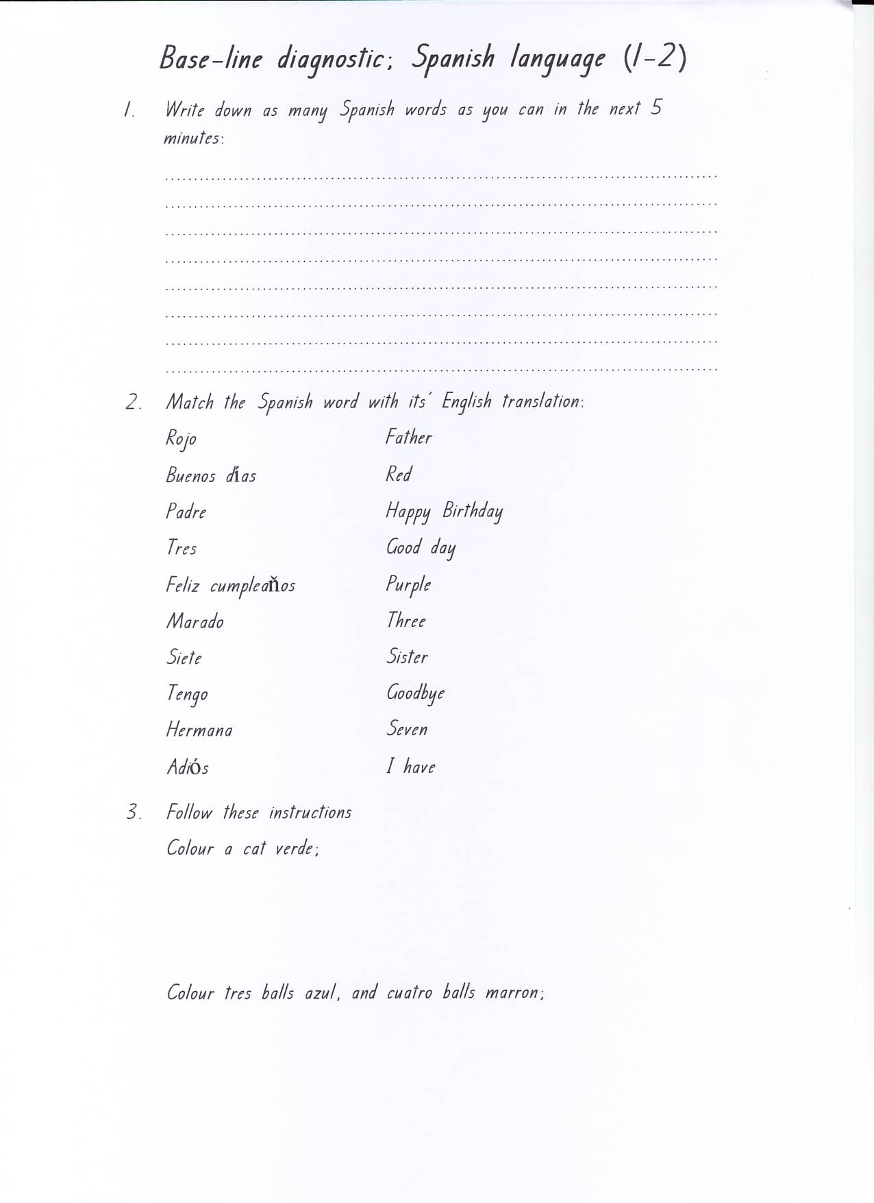
© Nielsen, 2007
© Nielsen, 2010

Slide 9
Spanish Language Diagnostic (Yrs 1-2) Feb 2005 & (Yrs 2-3) Feb 2006: Distance Travelled
 |  | COGNITIVE TASKS
Q | Avg per year level(s) | C O N T E N T | Oral Comprehension | Grapho-Phonological Correspondence. | Word Knowledge – Translation. | Recall of Vocabulary. | Written Comprehension. | Written Comprehension and Written Composition.
1 | Feb 2005 |  |  |  |  | 4.66
 | Feb 2006 |  |  |  |  | 7.3
 | Distance Travelled |  |  |  |  | 56.6%
2 | Feb 2005 |  |  |  | 3.6 / 36% (Matching 10 Spanish words with their English translation)
 | Feb 2006 |  |  |  | 7.3 / 73% (Matching 10 Spanish words with their English translation)
 | Distance Travelled |  |  |  | 121%
3 | Feb 2005 |  |  |  |  |  | 1.16 / 23% (5 target words assessed on numbers and colours)
 | Feb 2006 |  |  |  |  |  | 4.3 / 85% (5 target words assessed on numbers and colours)
 | Distance Travelled |  |  |  |  |  | 270%
© Nielsen, 2010

Slide 10
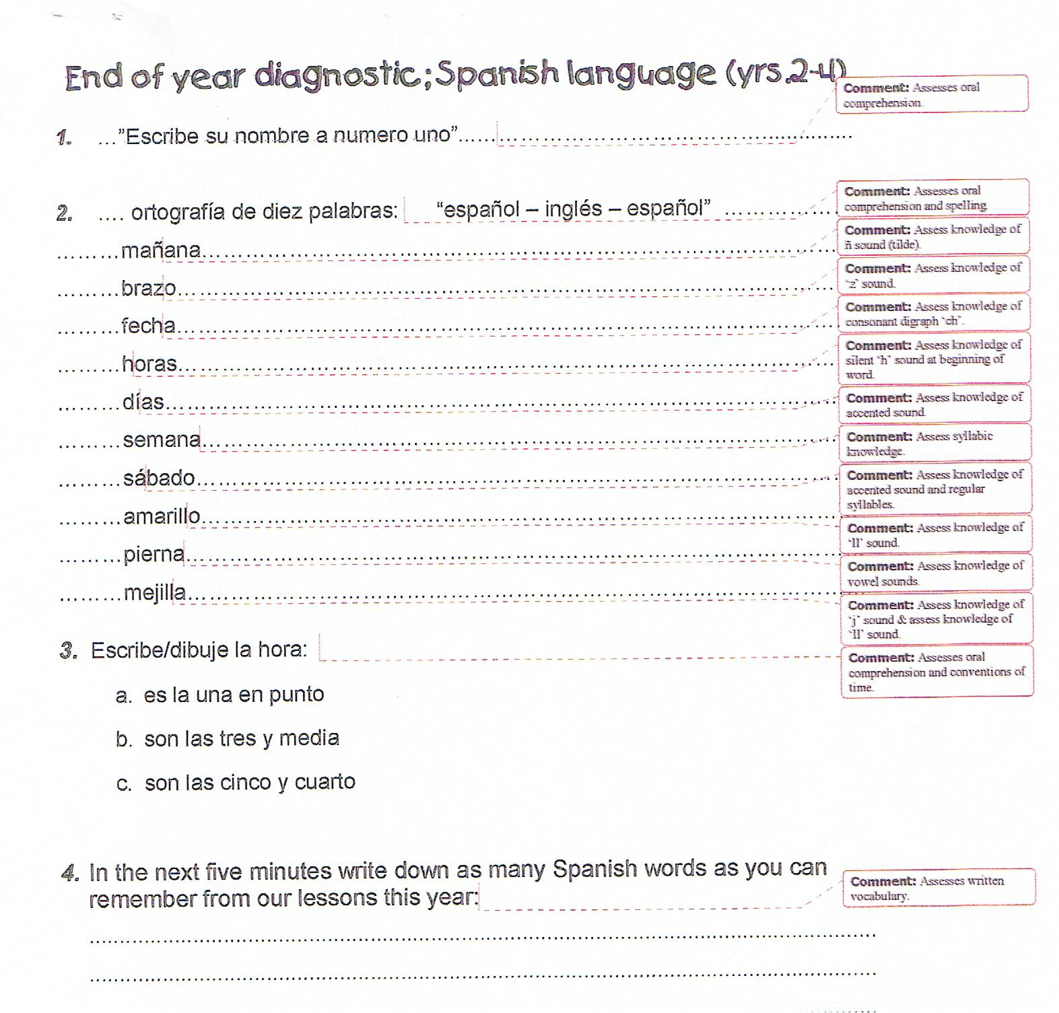
© Nielsen, 2010
Notes:
Language Learning Journal 2009: no standardised forms available as will be used for English, self-devised issue – internal consistency (questions, to program and moderation). Sparks et al., “long-term crosslinguisstic transfer of skills from L1 to L2” – 3 L2 teachers designed proficiency tests for their respective languages. Validity was considered to be achieved through uniformity of format: reading, writing, speaking and listening were all assessed, done with same prompts and directions. This model has been used in at least 4 other published studies by this author.
Different languages, different programs = different criteria/assessments. Focus on Distance Travelled as original!!!

Slide 11
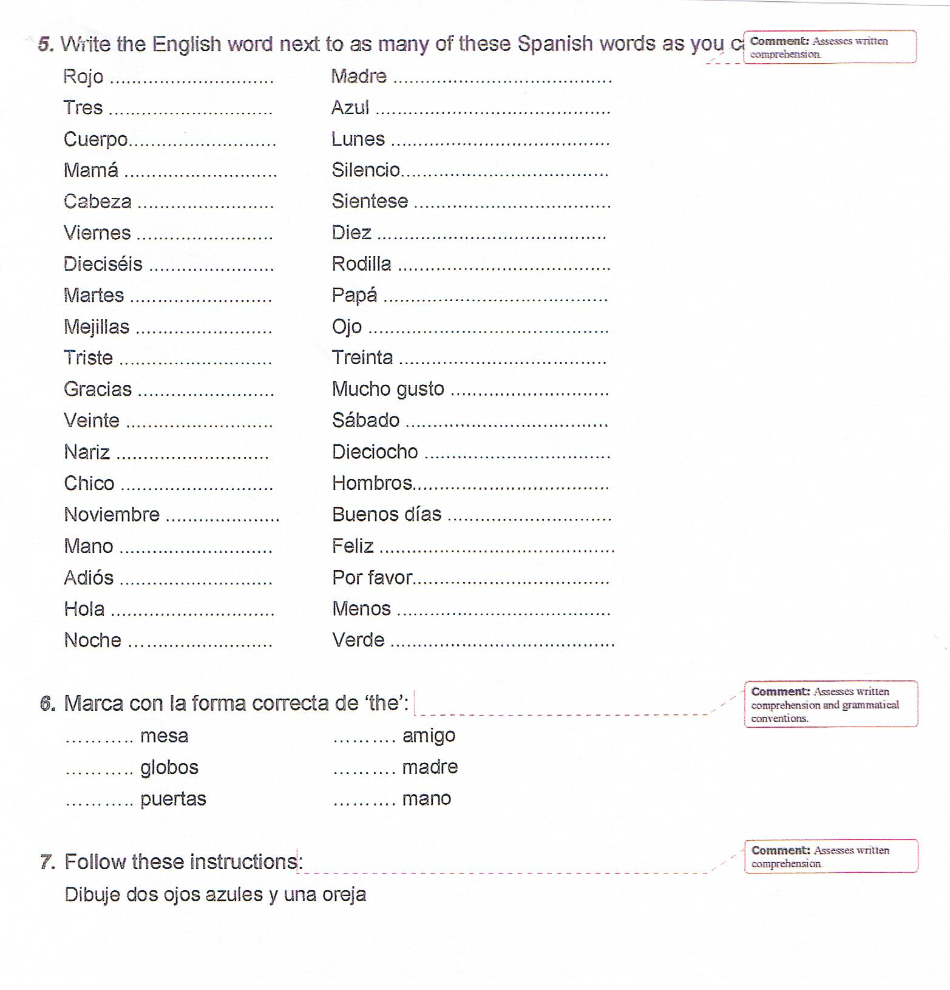
© Nielsen, 2010

Slide 12
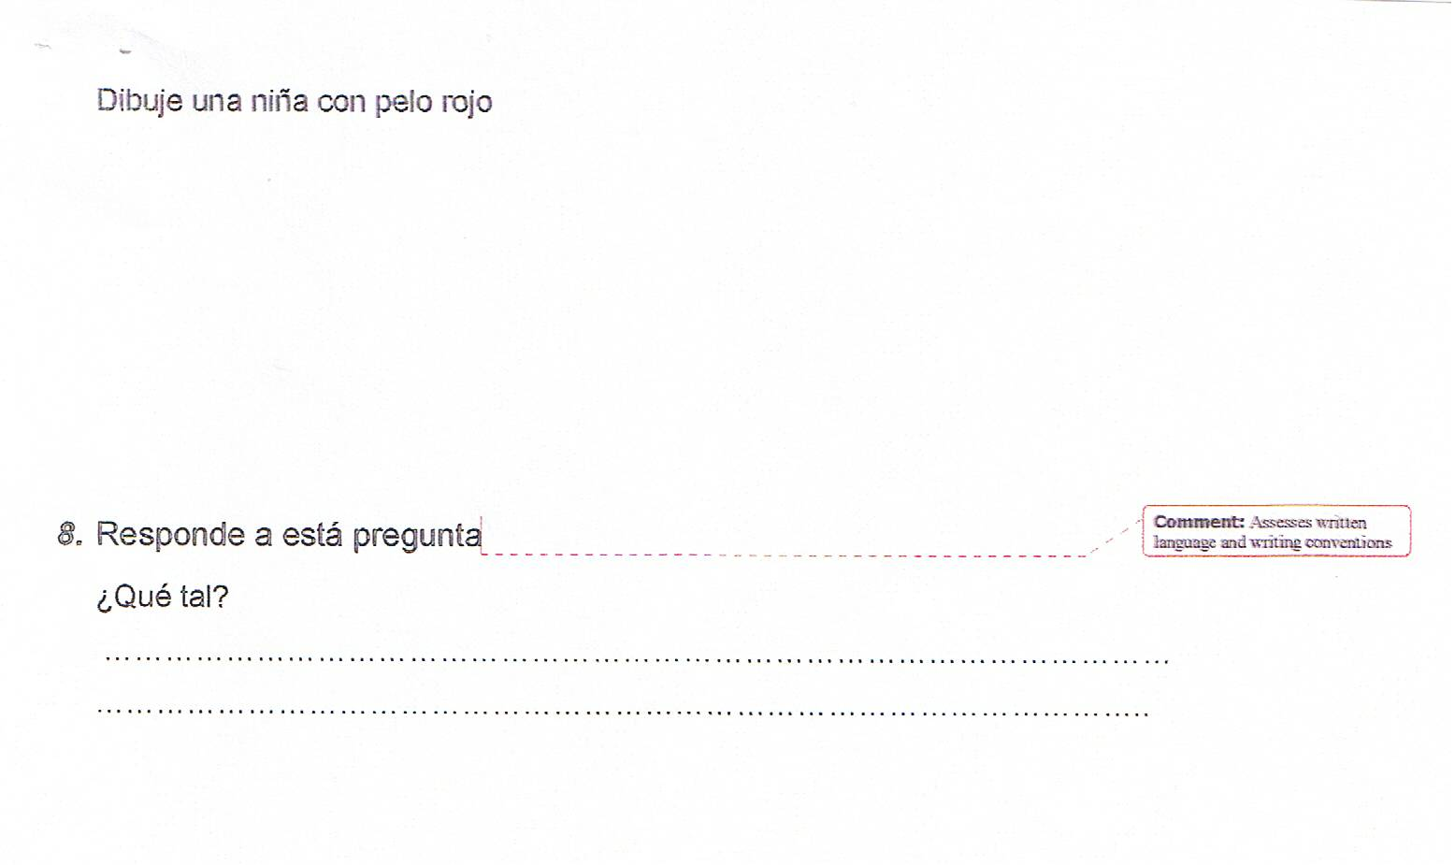
© Nielsen, 2010

Slide 13
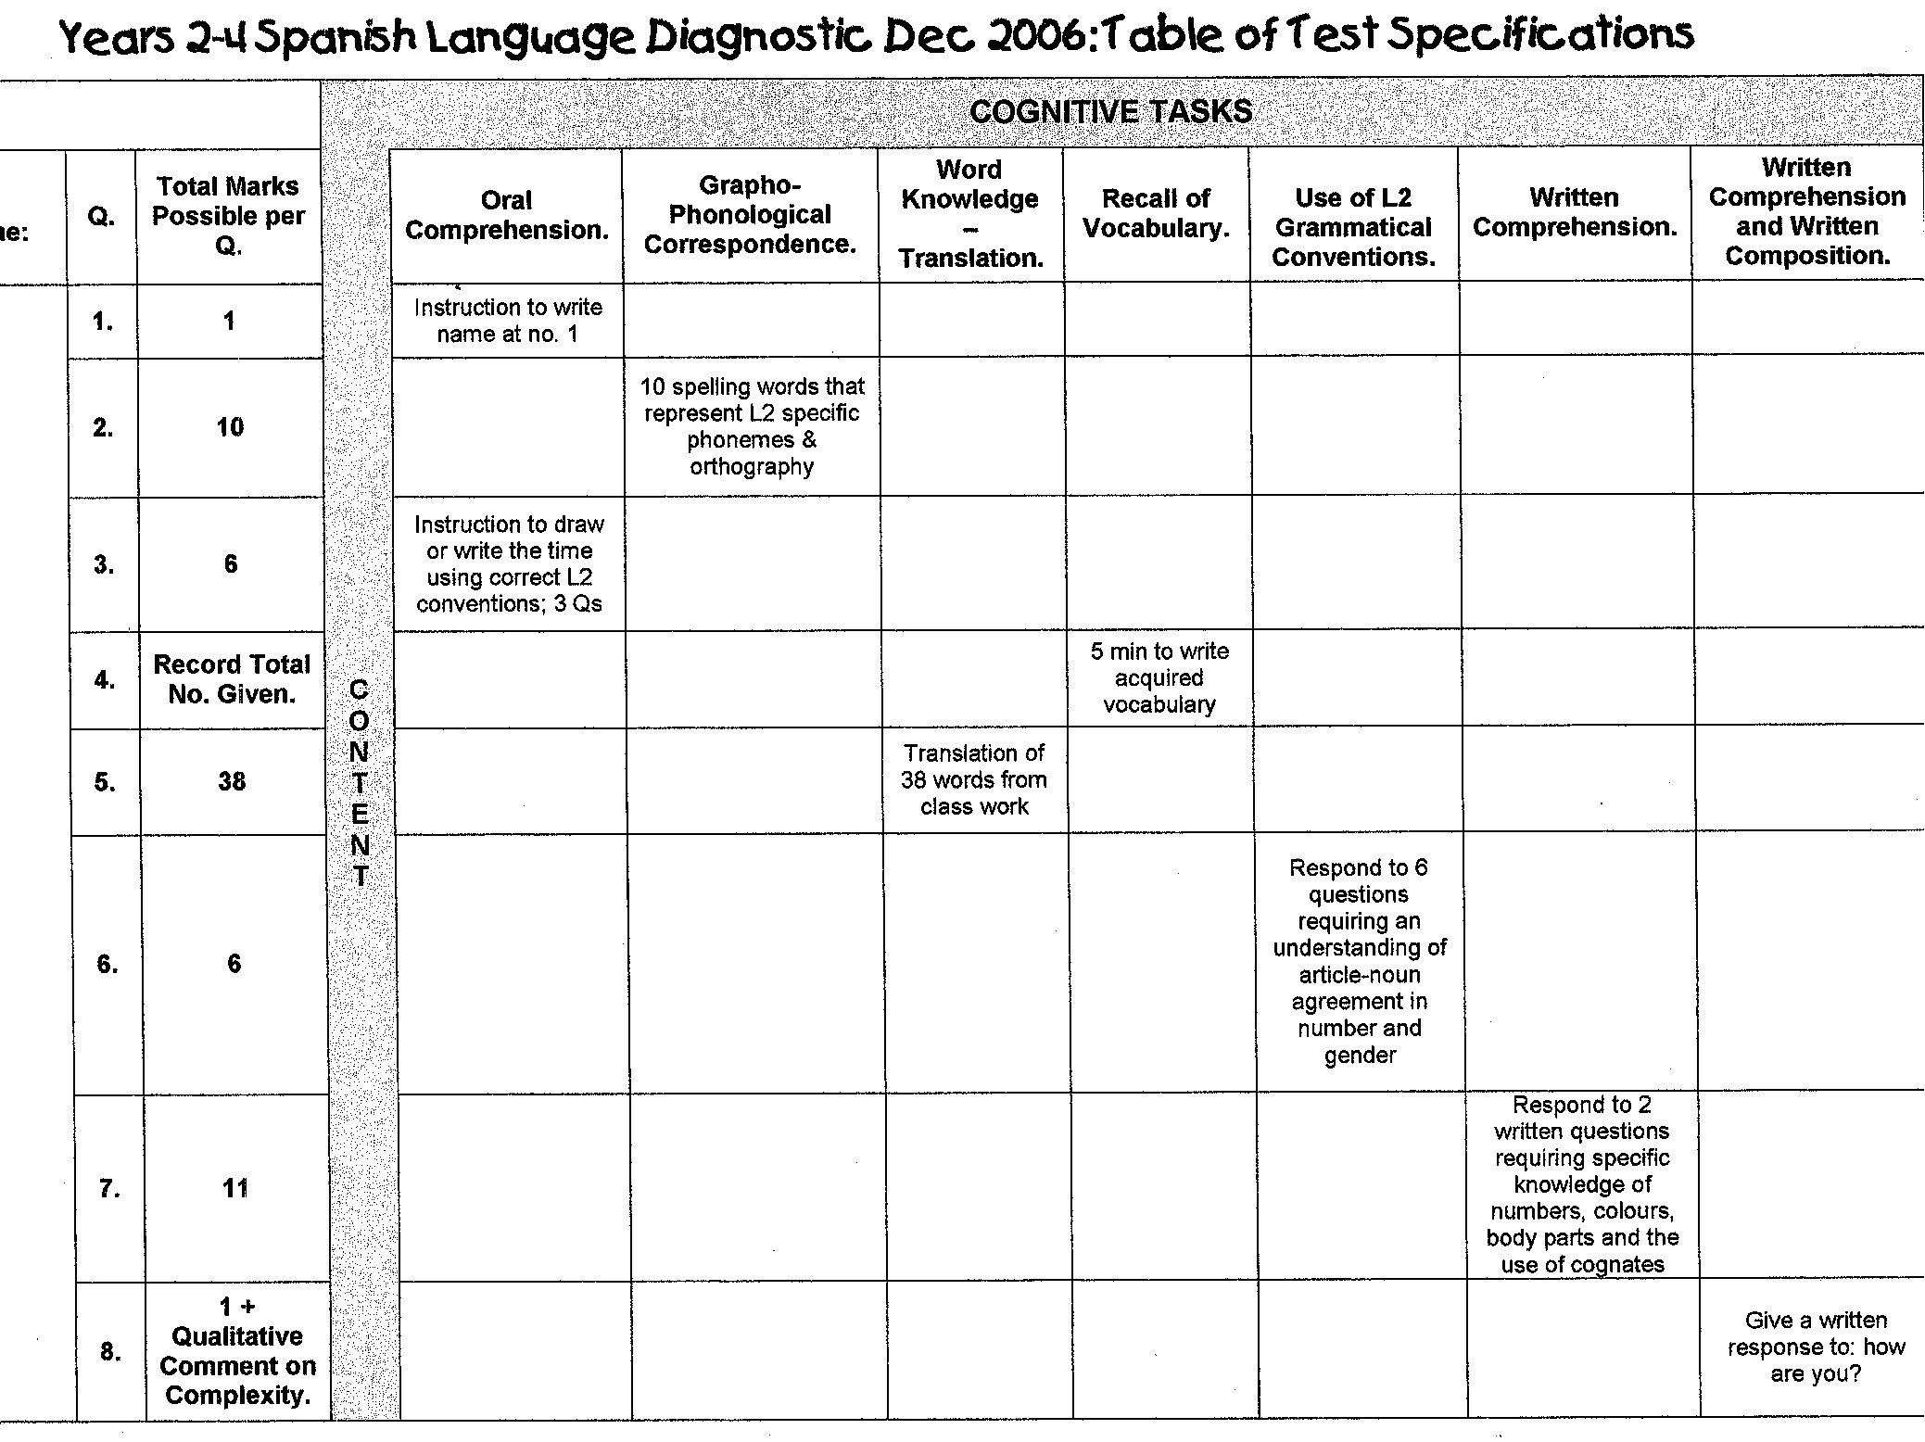
© Nielsen, 2010

Slide 14
Spanish Language Diagnostic (Yrs 2-3) Feb 2006 & (Yrs 2-3) Dec 2006: Distance Travelled
 | COGNITIVE TASKS
Avg No. per year level(s) | C O N T E N T | Oral Comprehension. | Grapho-Phonological Correspondence | Word Knowledge – Translation. | Recall of Vocabulary. | Use of L2 Grammatical Conventions | Written Comprehension. | Written Comprehension and Written Composition.
Feb 2006 |  |  |  |  | 7.3
Dec 2006 |  |  |  |  | 29
Distance Travelled |  |  |  |  | 297%
Feb 2006 |  |  |  | 7.3 / 73% (Matching 10 Spanish words with their English translation)
Dec 2006 |  |  |  | 19 / 50% (Writing English translations to 38 words in Spanish)
Distance Travelled |  |  |  | 160%
Feb 2006 |  |  |  |  |  |  | 4.3 / 85% (5 target words assessed numbers and colours and were given in bilingual questions)
Dec 2006 |  |  |  |  |  |  | 8.6 / 78% (11 target words assessed numbers, colours, body parts and the use of cognates which were given exclusively in L2 questions)
Dec 2006 |  | 1 / 100% & 5.4 / 90% | 5.8 / 58% |  |  | 3.4 / 57% |  | 1 / 100%
© Nielsen, 2010
Notes:
Depth AND Breadth!
What was working?
Why?
How?
In diff settings … leads to resonance/generalisation and the possibilty that we have uncovered some principles!!

Slide 15
…even though much action research is “difficult, messy, problematic, and, in some cases, inconclusive” (Nunan, 1993, p.46) it can provide valuable insights not just in terms of practice (e.g., to teachers who find themselves facing similar problems and concerns in their own classrooms), but even in terms of theory (i.e., theories of how second languages are acquired, how L2 literacy is developed)
SPANGLISH is the new ADLINGO
© Nielsen, 2010

Slide 16
New discoveries from the bilingual brain across the life span: educational implications?
Modern studies of the brain, language processing, reading, and how multiple languages are learned can:
Reveal vital information about timing in education (i.e., when is exposure to core content optimally learned)
Tell us about the mechanisms and the developmental sequences that underlie the learning of core content
Suggest ways of learning and teaching that can be used to circumvent problems associated with traditional teaching methods, as well as language remediation - and especially novel here, multi-lingual language remediation
Importantly, however, we found that the rapid acquisition of new language fundamentals was possible only when three key factors occurred: Exposure to the new language had to be extensive, systematic, and across multiple contexts. (Petitto, 2009, p.188)
Petitto, 2009; Kovelman, Berens, & Petitto, 2006 in preparation
© Nielsen, 2010

Slide 17
Planning for the 12th March
© Nielsen, 2010
Decide on baseline assessments to be used
Plan baseline assessment data collection
Work on developmental sequences
Bring any established programs, especially for vocab development
Discussions about joint program planning and multi-lingual methodologies . . . .
for example:

Slide 18
Reception to Year Seven Spanish Language Thematic Flowchart (composite classes)
Reception to Year One Flowchart:
RECEPTION & YEAR ONE | Term One | Term Two | Term Three | Term Four
Year A | Greetings / Classroom Instructions | Numbers | Colours | Family
Year B | Personal ID; name, age etc… | Descriptions of students; self & others | Clothing | Classroom Objects
Year Two to Year Three Flowchart:
YEAR TWO & YEAR THREE | Term One | Term Two | Term Three | Term Four
Year A | Feelings, Address, Telephone etc… | DVD Viewing | Weather & Seasons | Pets & Animals
Year B | Games & Sports | DVD Viewing | Time | Daily Routines & Activities
© Nielsen, 2010
(modified from: Krashen S & Terrell T Natural approach: language acquisition in the classroom)

Slide 19
Reception to Year Seven Spanish Language Thematic Flowchart (composite classes)
Year Four to Year Five Flowchart:
YEAR FOUR & YEAR FIVE | Term One | Term Two | Term Three | Term Four
Year A | Places to live, moving … | DVD Viewing | Household Rooms & Objects | Household Activities
Year B | Body Parts & Health | DVD Viewing | Health & Emergencies | Food, Drinks, Recipes & Eating Out
Year Six to Year Seven Flowchart:
YEAR SIX & YEAR SEVEN | Term One | Term Two | Term Three | Term Four
Year A | Money & Prices, Shopping… | DVD Viewing | Fashion & Clothing | Transport, Buying gifts …
Year B | Prepositions & Following Maps | DVD Viewing | Giving & Receiving Instructions (Imperatives) | Giving an Invitation, Making an Appointment
Source: Krashen S & Terrell Natural approach: language acquisition in the classroom 2000
© Nielsen, 2010
Notes:
ghjkhjkghjkghjk

Slide 20
Second Language Developmental Sequence for Oral Language: Spanish
Level | Descriptors | Examples
Preproduction | Responds with appropriate actions to simple requests and greetings. | Stands, sits, opens book, lines up …
Mixed Production | Action-based mixed oral language generally used to have wants met. Uses language of social interaction (manners etc…). | Can I go to the toilet por favor señor? Pass me the verde pencil por favor. Gracias, de nada.
Emerging Monologue | Simple sentences, requests and responses but with prompting for grammatical and lexical correctness. | ¿Puedo salir, por favor? ¿Qué tal amigo? Goma por favor señor.
Coherent Monologue | Longer statements, usually responses that can be understood. Uses descriptors and adverbial phrases of time and place. | Por el fin de semana, me gusta andar en bicicleta.
Beginning Dialogue | Developing automaticity now allows for spontaneous interactions in the Spanish language with increasingly accurate pronunciation. | Initiates and/or responds to topics of interest/study.
Literate Oral Language | Grammatically correct use of increasingly complex language and increasingly accurate pronunciation. | Sentence construction reflects understanding of Spanish linguistic and grammatical conventions such as word order, gender agreement, use of plurals …
© Nielsen, 2010

Slide 21
Second Language Developmental Sequence for Writing: Spanish
Level | Descriptors
Emerging | Recognises the similarities between writing in English and writing in Spanish Begins to write some commonly used Spanish words Able to copy simple sentences written in Spanish
Beginning | Utilises knowledge of the Spanish alphabet when attempting to write in Spanish Reproduces modelled sentences in Spanish Shows awareness of Spanish punctuation
Early | Utilises their knowledge of sounds and CV (consonant-vowel) syllable spelling and begins to use Spanish conventions for endings, blends, register and verbs Constructs simple sentences based on a model With modelling and assistance, incorporates feedback in revising and editing their own writing Begins to use conventional Spanish grammar, spelling, capitalisation, and punctuation
Independent | Able to construct a variety of sentence types Able to effectively convey meaning through writing in Spanish Regularly uses conventional grammar, spelling, capitalisation, and punctuation Able to revise and edit written work collectively
Literate | Consistently uses conventional Spanish grammar, spelling, capitalisation, and punctuation Able to address a topic or write to a prompt creatively and independently Revises and edits written work independently Produces many genres of writing in Spanish
© Nielsen, 2010

Slide 22
Second Language Developmental Sequence for : Spanish
Level | Descriptors
Emerging | Applies understanding of the reading process in English to reading in Spanish
Beginning | Matches spoken words to the written word Reproduces language patterns orally from familiar books Knows some letters of the Spanish alphabet (names, sounds) Uses illustrations and prior experience to help predict and read simple text in Spanish
Early | Knows a number of high frequency words Uses cueing systems (including Spanish phonics) to confirm the message of the text Demonstrates an awareness of details of print (e.g., punctuation, bold print, variations in format, etc…) Begins to self-monitor and self-correct while reading
Independent | Relies on syllabification strategies for decoding and encoding Able to retell and summarise Spanish text into English (translate) Uses knowledge of Spanish sentence structure and punctuation to aid meaning making Self-corrects if text doesn’t make sense
Fluent | Uses word identification strategies very effectively Consistently integrates and uses cueing systems to confirm the message of the text Gains meaning without translating Responds to Spanish text by making inferences, predictions, and generalisations
Literate | Rarely interrupts flow of reading to decode words Able to retell, summarise, and infer meaning, moving easily between Spanish and English Able to discuss point of view in Spanish or English
© Nielsen, 2010

